Slide 1

Topic: Percentages
EQ: How do we find the percentage of something?

Slide 2
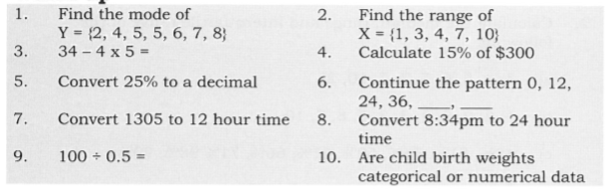
Always warm up so you don’t pull a braincell

Slide 3
24
7
30
Title: Percentages
Date
EQ –How do you find a percentage of an amount?
What are percentages used for?
Percentages are used everyday to compare and analyse.
Lets try it with $60
$6
$3
$0.60
There are three percentages that are easy to find without a calculator that can help you find any other amount.
10 % - Divide the number by 10 (or move the decimal place once to the left)
5% - half your 10% amount
1% - Divide the number by 100 ( or move the decimal place twice to the left)
How to find a percentage without a calculator?
5

Slide 4
Complete on LHS
Amount | $50 | $95
Find 10%
Find 5%
Find 1%
Find 18%
Find 55%

Slide 5
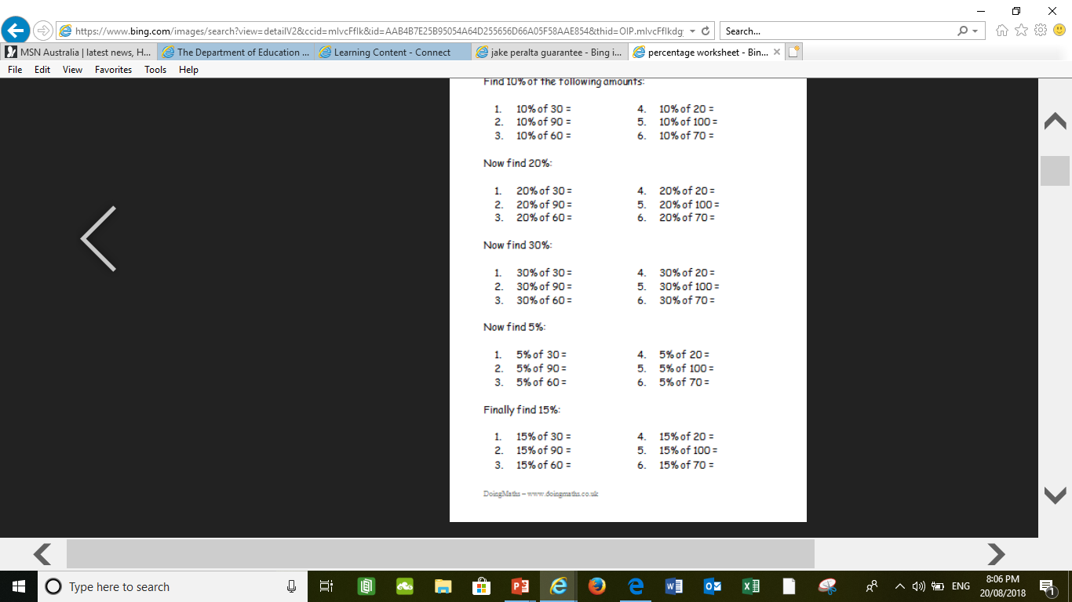
Try solving these without a calculator

Slide 6
Complete on LHS
Amount | $50 | $95
Find 10% | $5 | $9.50
Find 5% | $2.50 | $4.75
Find 1% | $0.50 | $0.95
Find 18% | $9 | $17.10
Find 55% | $27.50 | $52.25

Slide 7
24
7
30
Title: Percentages
Date
EQ –How do you find a percentage of an amount?
How to find a percentage with a calculator?
Convert your percentage to a decimal (divide my 100 or move the decimal place twice to the left) and then multiply by the amount
Ex. Find 15% of 70
A few tricky percentages to convert :
Less than 10%
2% 0.02
6% 0.06
More than 100%
115% 1.15
180% 1.80
200% 2.00
15% as a decimal 0.15
0.15 × 70 = 10.5
10.5 is 15% of 70
Try these on your left hand side:
16% of 65
88% of 98
3% of 70
5

Slide 8
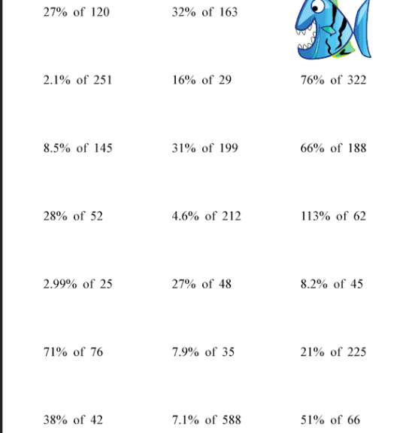
Lets step it up and make it a bit more challenging. Time to practise using a calculator.

Slide 9
Complete the worksheet for a tad more practise.

